Slide 1
INDIAN PREMIER LEAGUE DATA ANALYISIS
BY PUJALA SAMPATH

Slide 2

Introduction
CONTENT
This presentation explores cricket match data using structured query language (SQL) to derive key insights. The dataset captures detailed information about individual deliveries in matches, including match identifiers, players involved, runs scored, and bowling performance. The analysis focuses on uncovering patterns such as top-performing batsmen, bowlers, and high-scoring overs.
The goal of this project is not only to understand cricket dynamics but also to demonstrate how SQL can be used to process and analyze real-world data efficiently. Each query is tailored to answer specific questions about team and player performance. The results are presented in a clear and visual manner to ensure accessibility and engagement for all audiences, regardless of their technical expertise.
By leveraging the power of SQL and visualization, this project provides a glimpse into how data analytics plays a vital role in sports strategy and decision-making.

Slide 3
Overview of analysis
OBJECTIVE
Dataset Understanding: Begin by exploring the dataset to understand its structure, tables, and columns.
Insight Extraction: Use SQL queries to extract key information such as player performances, match statistics, and team comparisons.
Data Analysis: Implement queries to answer critical questions about batting and bowling trends, high-performing players, match dynamics, etc.
Significance: Provides a foundation for deeper statistical and predictive analysis and Helps cricket analysts, coaches, and fans derive meaningful insights.
.

Slide 4

Dataset Overview
Dataset Name : Deliveries
match_id : Unique identifier for each match.
Inning : Indicates the current inning of the match.
batting_team : The team currently batting.
bowling_team : The team currently bowling.
Over : The over number in the inning.
Ball : The ball number in the over.
Batsman : Name of the batsman facing the ball.
non_striker : Name of the batsman at the non-striker's end.
Bowler : Name of the bowler delivering the ball.
is_super_over: if the ball is from a super over (1 for yes, 0 for no).
wide_runs: Runs scored due to a wide ball.
bye_runs: Runs scored as byes.
legbye_runs: Runs scored as leg-byes.
noball_runs: Runs scored off a no-ball.
penalty_runs: Penalty runs awarded to the batting team.
batsman_runs: Runs scored by the batsman off this ball.
extra_runs: Additional runs awarded to the batting team.
total_runs: Total runs scored in this delivery.
player_dismissed: Name of the player dismissed, if any.
dismissal_kind: Type of dismissal (e.g., bowled, caught, run-out).
fielder: Name of the fielder involved in the dismissal, if applicable.
IPL INAUGURATION EVENT

Slide 5

SQL Queries - Insights into Cricket Performance….

Slide 6

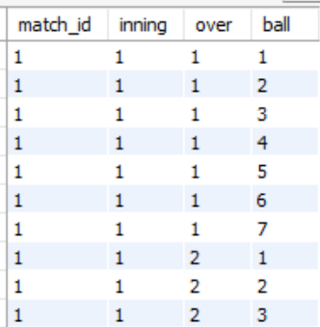

Query
Retrieves match ID, inning, over, and ball details for all deliveries.
Query Code
Output
Insight: Useful for understanding the flow of the match ball by ball

Slide 7


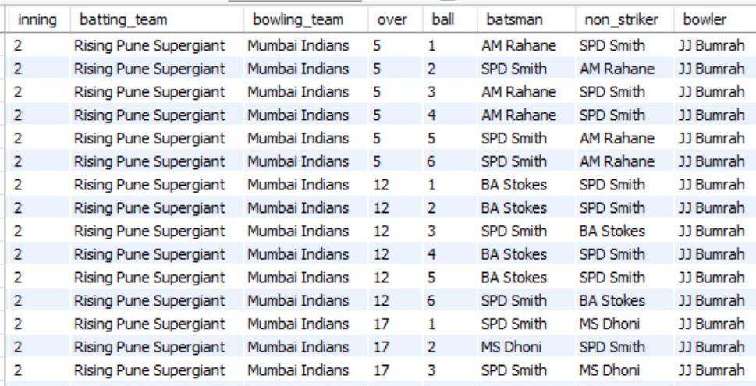
Query
Displays all columns for deliveries bowled by JJ Bumrah.
Query Code
Insight: Helps analyze the performance of
JJ Bumrah a key bowler
Output

Slide 8

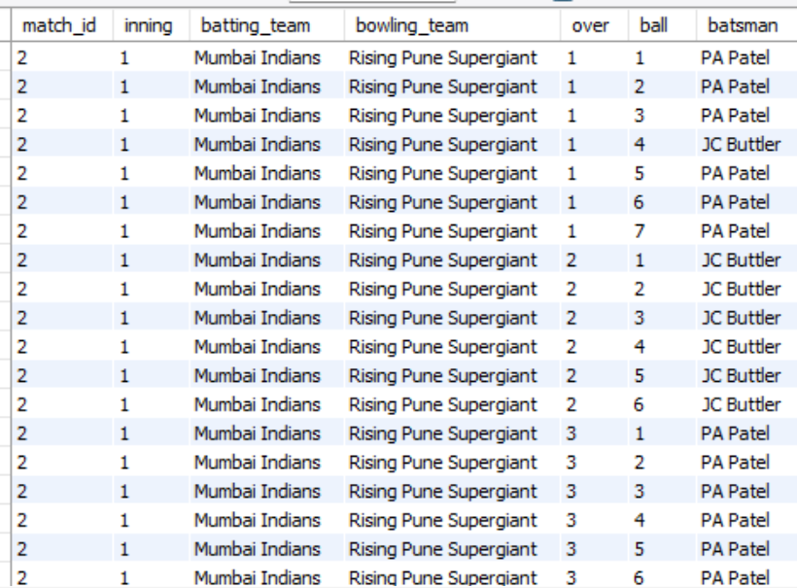
Query
Lists all deliveries where the batting team is Mumbai Indians.
Query Code
Output
Insight: Useful to study the batting performance of Mumbai Indians.

Slide 9

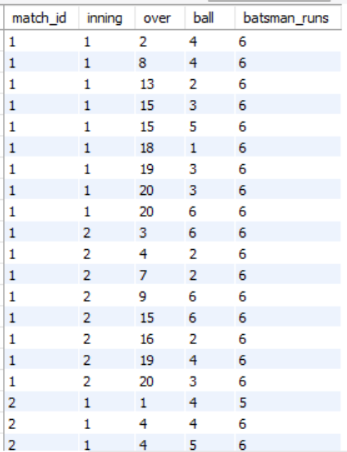

Query
Displays deliveries where batsmen scored more than 4 runs.
Query Code
Output
Insight: Highlights big shots like boundaries and sixes.

Slide 10


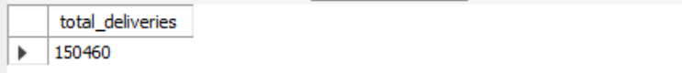
Query
Counts the total number of deliveries bowled in the dataset..
Query Code
Output
Insight: Essential for understanding the size of the dataset.

Slide 11
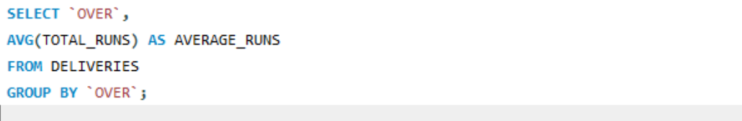
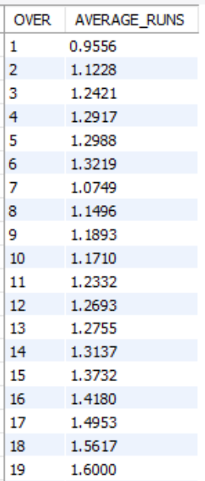

Query
Finds the average number of runs scored in each over..
Query Code
Output
Insight: Identifies overs where teams scored heavily or struggled.

Slide 12
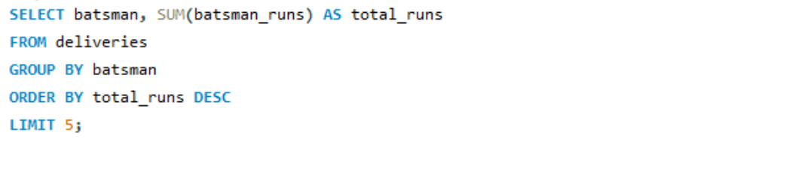
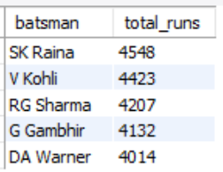

Query
Lists the top 5 batsmen with the highest total runs scored.
Query Code
Output
Insight: Identifies the best-performing batsmen in the dataset.

Slide 13
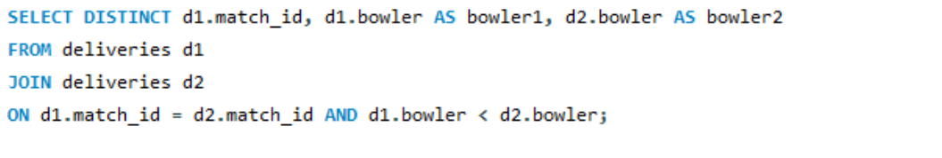
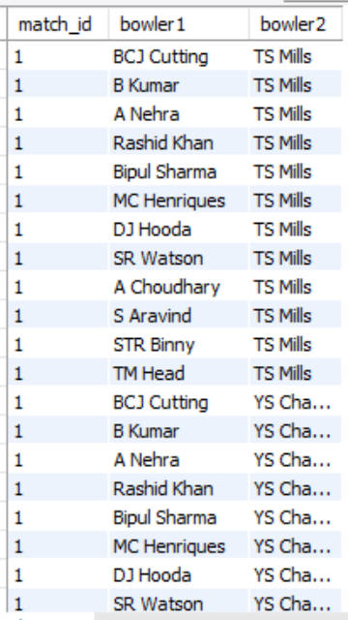


Query
Lists pairs of bowlers who bowled in the same match.
Query Code
Output
Insight: Useful for analyzing bowling combinations in a match

Slide 14

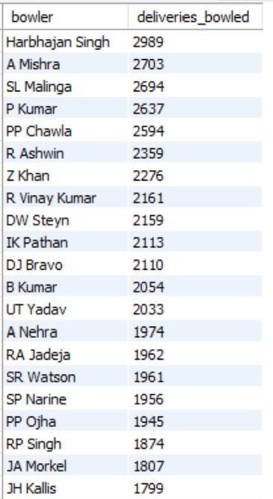


Query
Counts the total deliveries bowled by each bowler.
Query Code
Output
Insight: Highlights bowlers with significant contributions.

Slide 15
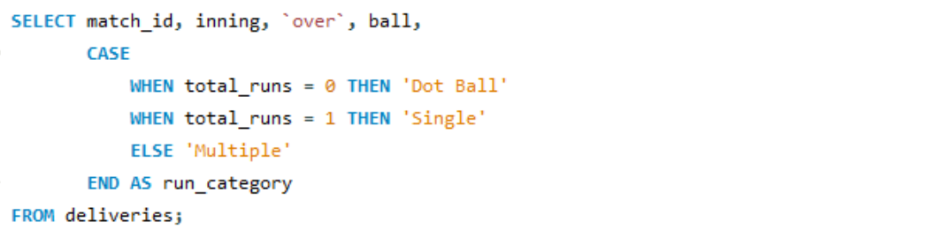
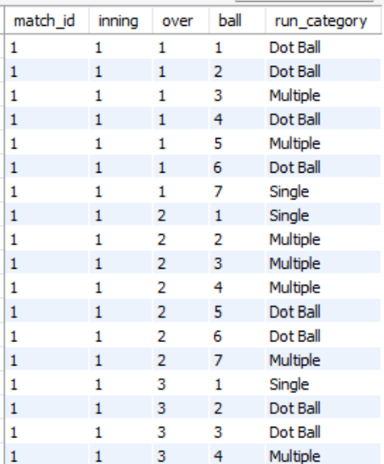

Query
Categorizes deliveries as Dot Ball, Single, or Multiple based on runs scored..
Query Code
Output
Insight: Simplifies analysis of delivery outcomes.

Slide 16
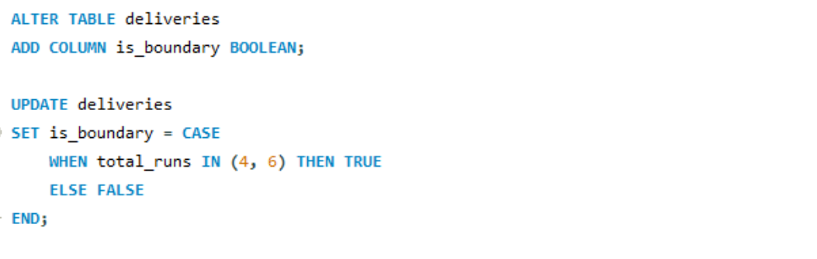
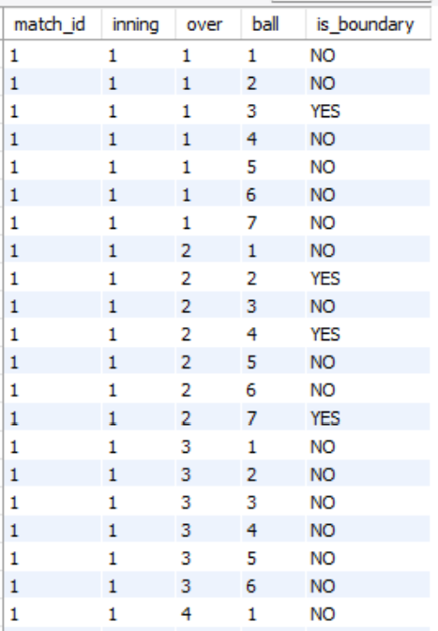
Add new column to flag deliveries that resulted in boundaries (4 or 6 runs).
Query
.
Query Code
Output
Insight:
Simplifies filtering and analysis of boundary deliveries.
Helps identify aggressive batting patterns and key moments in the match11.

Slide 17
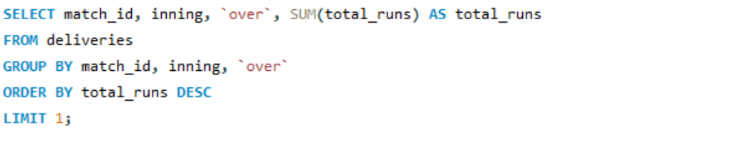


Query
Highest Total Runs in an Over.
Query Code
Output
Insights:
Identifies the over where the highest number of runs were scored.
Useful for understanding high-impact moments in the matches.

Slide 18


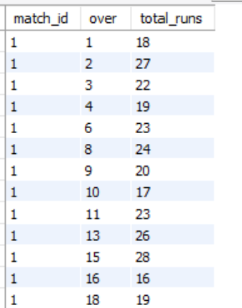
Query
High-Scoring per Over using “VIEW”
Query Code
Output
Insights:
Highlights overs where total runs exceeded 15.
Allows focus on aggressive gameplay or weak bowling performance.

Slide 19
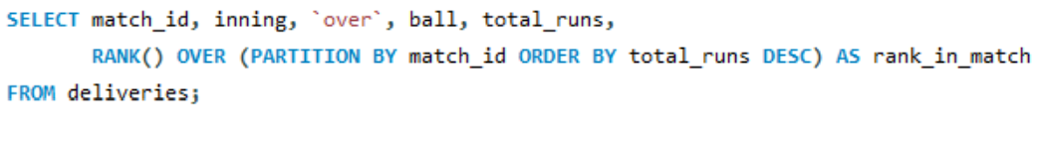
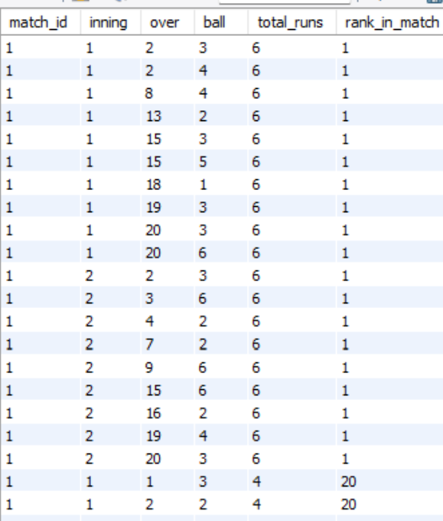
Query
Rank Deliveries by Total Runs
Query Code
Insights:
Assigns ranks to deliveries within each match based on runs scored.
Enables identification of impactful balls in matches.
Output

Slide 20
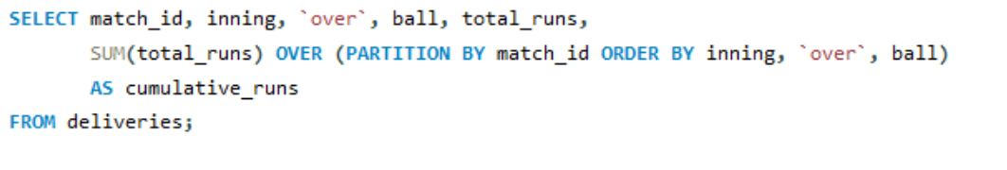
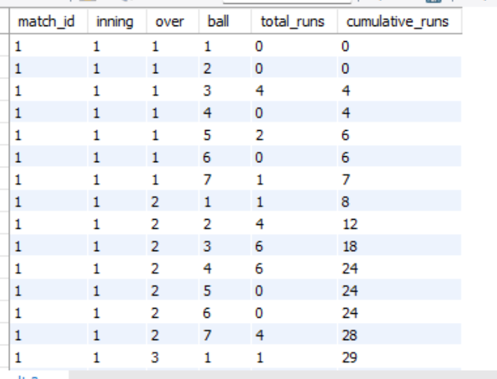
Query
Cumulative Runs in Each Match
Query Code
Output
Insights:
Tracks the progression of runs scored in a match.
Useful for visualizing momentum shifts during gameplay.

Slide 21
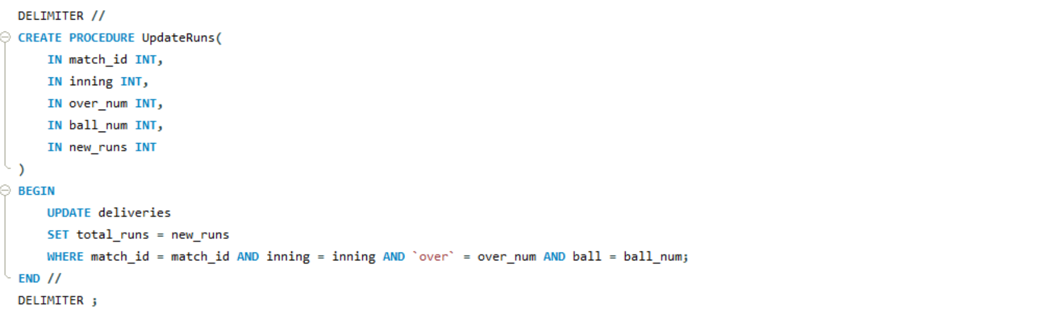
Query
Update Runs Using a Procedure
Query Code
Insights:
Provides a way to correct or update runs data for a specific delivery.
Ensures data consistency and accuracy.

Slide 22
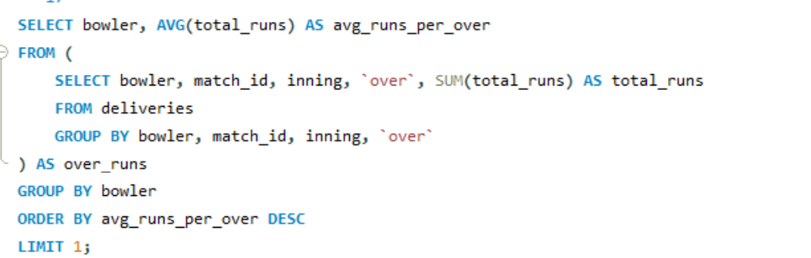

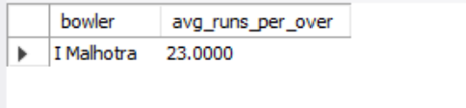
Query
Bowler with Highest Average Runs Per Over
Query Code
Output
Insights:
Determines the bowler who concedes the most runs on average.
Useful for identifying bowlers struggling with economy.

Slide 23
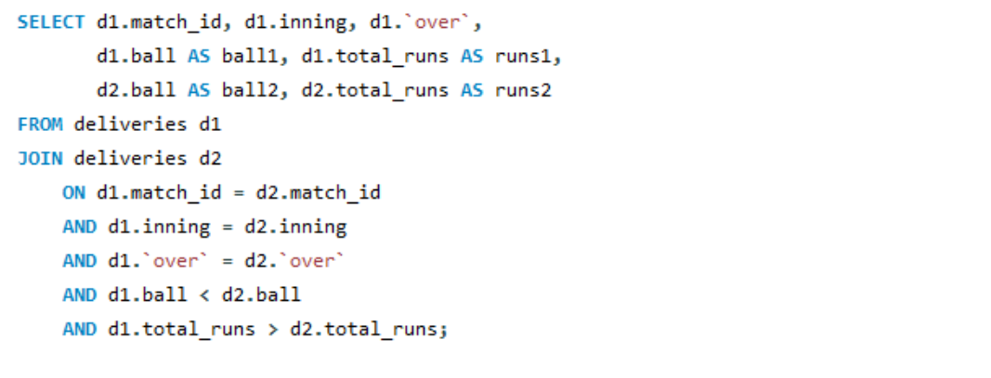
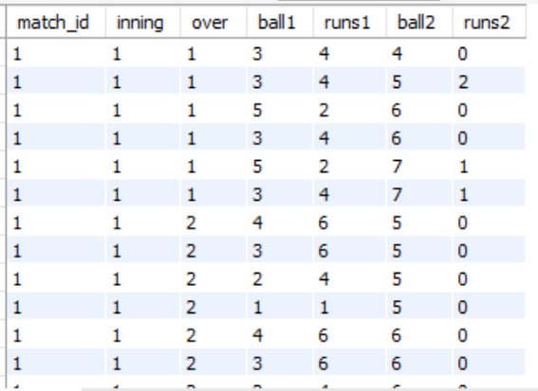
Query
Compare Runs in Same Over
Query Code
Output
Insights:
Compares runs scored on different deliveries in the same over.
Identifies patterns of fluctuation in bowler performance.

Slide 24
CONCLUSION
This project demonstrates the power of SQL in analyzing and extracting valuable insights from a cricket dataset. Explore key match events, such as boundary deliveries, highest-scoring overs, and top-performing players.
Leverage advanced SQL techniques, including window functions, stored procedures, and views, to derive deeper insights.
Highlight patterns that can aid in strategic decision-making, like identifying impactful bowlers and batsmen.
Key Takeaways:
SQL is an essential tool for handling and analyzing large datasets.
The cricket dataset offers opportunities for uncovering performance trends and match dynamics.
Effective data analysis can help stakeholders make informed decisions in sports analytics.
The project emphasizes the importance of structured data and query optimization for efficient analysis of large datasets.
Insights derived from this analysis can serve as a foundation for advanced analytics, including predictive modeling and trend forecasting in cricket.

Slide 25
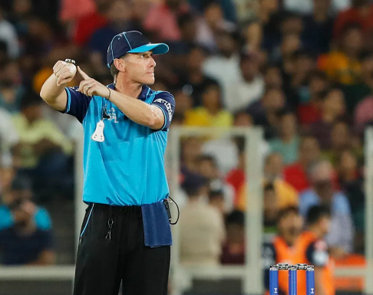
TIME OUT
THANK YOU

